Slide 1
SDPi Supplement Diagrams

Slide 2
SDPi-P Actor Diagram
2020.08.28A
SOMDS Participant
SOMDS Connector
Non-SOMDS Systems
SOMDS
Provider
(MDIB, Services, …)
SOMDS FHIR Gateway
SOMDS Consumer
(consume MDIB info, invoke services, …)
SOMDS V2 Gateway
SOMDS Sensor Gateway
SOMDS Smart App Platform
Smart Apps
(incl. SAMD)

Slide 3
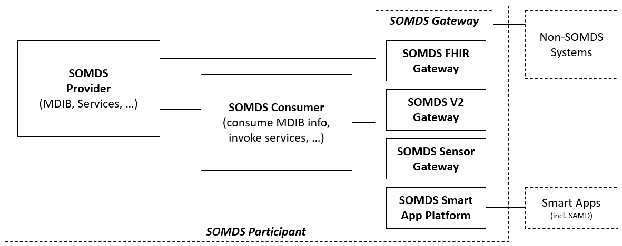
SDPi-P Actor Diagram
2020.08.18A
Lost File!

Slide 4
SDPi-P Actor Diagram
2020.08.14A
SOMDS Participant
Non-SOMDS Systems
SOMDS
Provider
(MDIB, Services, …)
SOMDS Gateway
SOMDS Consumer
(consume MDIB info, invoke services, …)
SOMDS FHIR Gateway
SOMDS V2 Gateway
SOMDS Sensor Gateway

Slide 5
SDPi-P Actor Diagram
2020.08.14A
SOMDS Participant
Non-SOMDS Systems
SOMDS
Provider
(MDIB, Services, …)
SOMDS Gateway
SOMDS Consumer
(consume MDIB info, invoke services, …)
SOMDS FHIR Gateway
SOMDS V2 Gateway
SOMDS Sensor Gateway

Slide 6
SDPi-P Actor Diagram
2020.08.1A
Lost original!

Slide 7
SDPi-P Actor Diagram
2020.08.14A
SOMDS Participant
Non-SOMDS Systems
SOMDS
Provider
(MDIB, Services, …)
SOMDS Gateway
SOMDS Consumer
(consume MDIB info, invoke services, …)
SOMDS FHIR Gateway
SOMDS V2 Gateway
SOMDS Sensor Gateway

Slide 8
SDPi-P Content Actor Diagram
2020.08.12A
Provide Content
BICEPS
Content
Creator
BICEPS
Content
Consumer

Slide 9
SDPi-P Actor Diagram
2020.08.10B
SOMDS Participant
Non-SOMDS Systems
SOMDS
Provider
(MDIB, Services, …)
SOMDS Gateway
SOMDS Consumer
(consume MDIB info, invoke services, …)
SOMDS FHIR Gateway
SOMDS V2 Gateway
Workflow Context? Actor?
Ensemble Context? Actor?

Slide 10
SDPi-P Content Actor Diagram
2020.08.07D
Provide Content
SOMDS
Content
Creator
SOMDS
Content
Consumer
(SOMDS-Based Exchange)

Slide 11
SDPi-P Actor Diagram
2020.08.07C
SOMDS Participant
Non-SOMDS Systems
SOMDS
Provider
(MDIB, Services, …)
SOMDS Gateway
SOMDS Consumer
(consume MDIB info, invoke services, …)
SOMDS FHIR Gateway
SOMDS V2 Gateway
Workflow Context? Actor?
Ensemble Context? Actor?

Slide 12
SDPi-P Actor Diagram
2020.08.07B
SOMDS Participant
Non-SOMDS Systems
SOMDS
Provider
(MDIB, Services, …)
SOMDS Gateway
SOMDS Consumer
(consume MDIB info, invoke services, …)
SDC-FHIR Gateway
SDC-V2 Gateway
Workflow Context? Actor?
Ensemble Context? Actor?

Slide 13
SDPi-P Actor Diagram
2020.08.07A
SOMDS Participant
Non-SOMDS Systems
SOMDS
Provider
(MDIB, Services, …)
SOMDS
Gateway
SOMDS Consumer
(consume MDIB info, invoke services, …)
SDC-FHIR Gateway
SDC-V2 Gateway
Workflow Context? Actor?
Ensemble Context? Actor?

Slide 14
SDPi-P Actor Diagram
2020.08.06A
SOMDS Participant (MDIB, Context, …)
Non-SOMDS Systems
SOMDS
Provider
(MDIB, Services, …)
SOMDS
Gateway / Enterprise Proxy
SOMDS Consumer
(consume MDIB info, invoke services, …)
SDC-FHIR Gateway Proxy OR
EHR Proxy
OR
Patient Identity
…
Workflow Context? Actor?
Ensemble Context? Actor?

